Slide 1
FWD Project
TOGAF 9 - Core Diagrams Value Chain Diagrams Phase A – Architecture Vision

Slide 2
Value Chain Diagram

Slide 3
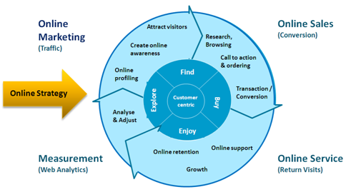
Value Chain Diagram

Slide 4
Value Chain Diagram

